Slide 1
Hypertext Theory
ENGL306
Ana Milena Ribero
University of Arizona

Slide 2
What is a hypertext?
Rejects linearity
Non-sequential
1965
1989 – the World Wide Web
Eliminates the author’s power to determine the order in which we receive information
Nodes and links
Navigation

Slide 4
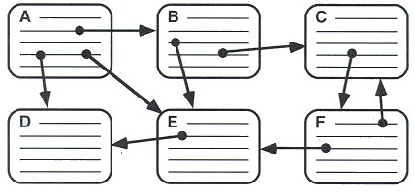

Slide 5
The rules:
A large body of information is organized into numerous fragments.
The fragments relate to each other.
The user needs only a small fraction of information at a time.

Slide 6
Types of hypertexts
Read-only hypertexts
Ones that allow readers to make contributions

Slide 7
Poststructuralist Theory
Rejects the validity of structures as ways to understand/organize the world
Textual order and structure are abandoned
Roland Barthes:
The author is dead
Readerly texts
Writerly texts

Slide 8
Deconstruction
Jacques Derrida:
Texts have many different meanings
Abandon ways of thinking based on ideas of center, margin, hierarchy, and linearity
Replace them with multilinearity, nodes, links, and networks
Rejects logocentrism.

